Slide 1

Dispatcher Architecture
Implemented in x86-64
By Michael Almandeel

Slide 2
Memory Structure
Physical Memory
The kernel is loaded at boot time into the bottom of the physical address space
The virtual address’s and the physical address’s of the kernel memory that the page table maps to are identical for all processes
Users cannot access these pages due a protection key, which is set to privileged during process creation
Kernel Space User Space
Virtual Address = Physical Address
Virtual Memory
Kernel Space PID = 2
Virtual Address = Physical Address
Virtual Memory
Kernel Space PID = 1263

Slide 3
Page Tables
Pid = 5
Pid = 632
There is one page table per process
A page table comprises 4 or 5 levels
Each page table is associated with a unique id
This id is called the page table index and is stored in the %cr3 register
This id is identical to the associated process’s PID!
Kernel pages cannot be thrashed, they must reference the same physical addresses at all times
V_Addr:
0 – 600mb
Pk = 0
V_Addr:
600mb - ?
Pk = 3
V_Addr:
0 – 600mb
Pk = 0
V_Addr:
600mb - ?
Pk = 3
Kernel Space PID = 632 PID = 5
Physical Memory

Slide 4
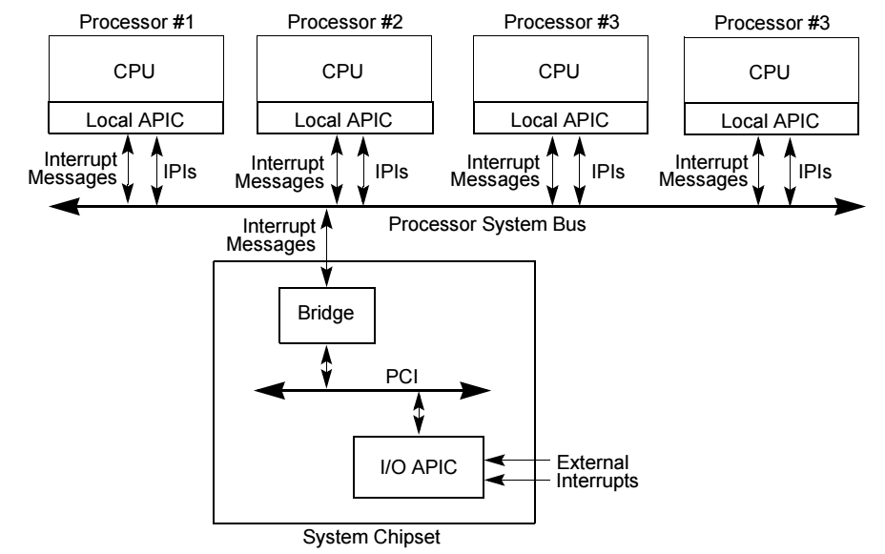
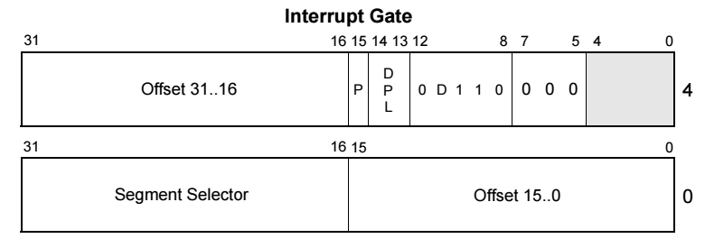
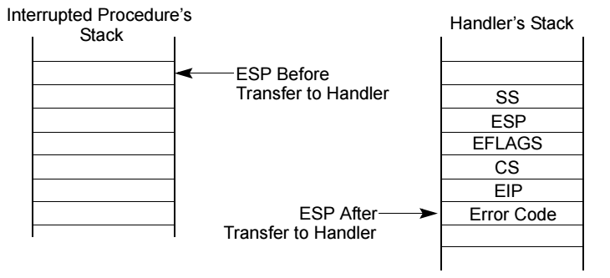
Interrupts
Interrupts are delivered to a core via it’s own local apic (advanced programmable interrupt controller)
When an interrupt occurs, the vector is looked up in the IDT
Each IDT entry contains an Interrupt gate which contains the isr’s entry point
Execution critical registers are pushed to the kernel stack, and execution begins at the entry point
Isr developers must always push any registers before use and pop them back before returning to avoid losing the state of the interrupted program

Slide 5
Interrupts, Continued
Interrupts execute in privileged mode by default
2 Kinds of interrupts: maskable and non-maskable(NMI’s)
An NMI cannot be interrupted
A maskable interrupt can only be interrupted by an NMI
Interrupts are assigned a priority level , which is used to order their delivery to the core
An isr will run uninterrupted(except by an NMI) until it executes IRETQ
IRETQ restores the registers saved on the kernel stack and returns control to the user where they were initially interrupted, and also signals to the local apic that maskable interrupts are reenabled

Slide 6
A Simple Dispatcher
The dispatcher context switches from the currently running process to the first process on the ready queue, after it’s burst time has expired, and places the interrupted process to the rear of the ready queue
In order to facilitate this, we set the timer on the local apic to burst time when initially dispatching the process, and utilize the isr associated with the timer to jump into the entry point of the dispatcher when burst time has expired(which calls the timer isr)
A context switch entails saving the state of the currently running process to it’s pcb, and restoring the state of the pcb that corresponds to the first task on the ready queue. Changing %CR3 causes us to transition to the new process’s address space on the next instruction
Note the same kernel instructions and entry points are in the same virtual address’s among all address spaces, which all map to the same physical addresses, so the transition of execution across address spaces is seamless
Once state is saved and restored, we set the new burst time, and pass control to the restored process
We pass control by overwriting the register values pushed onto the kernel stack by the timer isr with their corresponding values in the current pcb, and call IRETQ, as if we are the timer interrupt

Slide 7
Simple Dispatcher Continued
Problems:
When a process is interrupted, the isr hijacks it’s burst time
No way to deliver interrupts that are intended for a specific process
apic
apic
kernel
interrupt
kernel
pcb’s
timer isr
set timer
jump
context switch
task dispatcher
task dispatcher
IRETQ
%CR3 = 5
save
%CR3 = 631
user
%RIP
%RIP
user

